Slide 1


From Water Jars to Code
ALEX KAROBIA NJOKI | BSC. IT

Slide 2

The Foundation of My Journey
MUHOTETU, LAIKIPIA
Growing up in Muhotetu instilled resilience, resourcefulness, and a deep sense of community, shaping my core values and life perspective.

Slide 3

The Family Anchor
MOTHER RAHAB NJOKI
Strength under scarcity, my mother taught me resilience, ensuring our family thrived amidst challenges, instilling values that guided my journey forward.
SISTER PERPETUAL
Sharing burdens with my sister, we embraced life's trials together, fostering a bond that strengthened our resolve to overcome obstacles in unity.

Slide 4
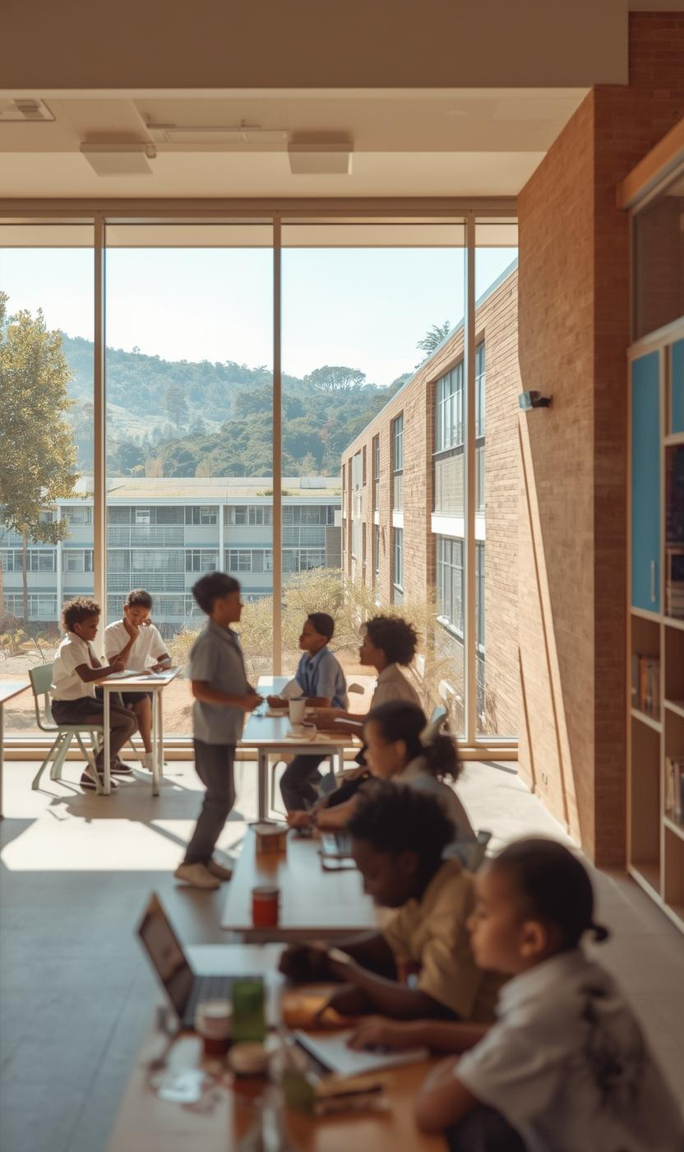
The Journey of Formal Education
TRANSITION TO CHERETA
Attending Chereta Secondary School introduced me to structured learning, formal systems, and the importance of education as a gateway to opportunity.

Slide 5

The Moment That Changed Everything
A CALL TO ACTION
A pivotal moment arrived when my cousin declared, “You will study IT,” igniting my passion for technology despite my initial fears.

Slide 6
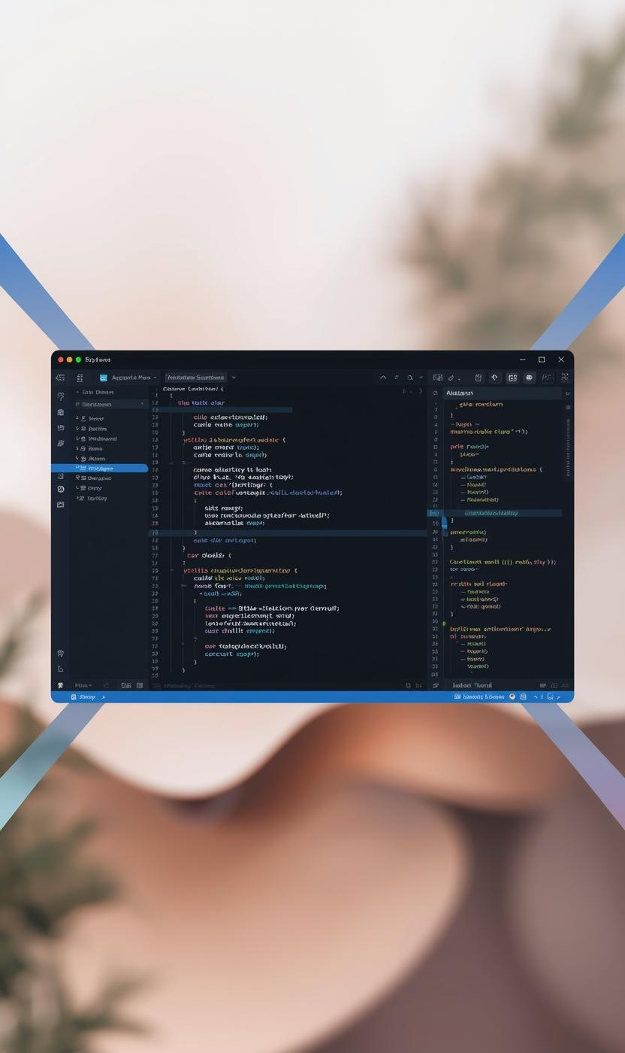
The Rite of Passage Through Learning
TRANSFORMATIVE JOURNEY IN TECH
Embracing long hours and overcoming bugs, I forged my identity as a developer during my time at Teach2Give.

Slide 7
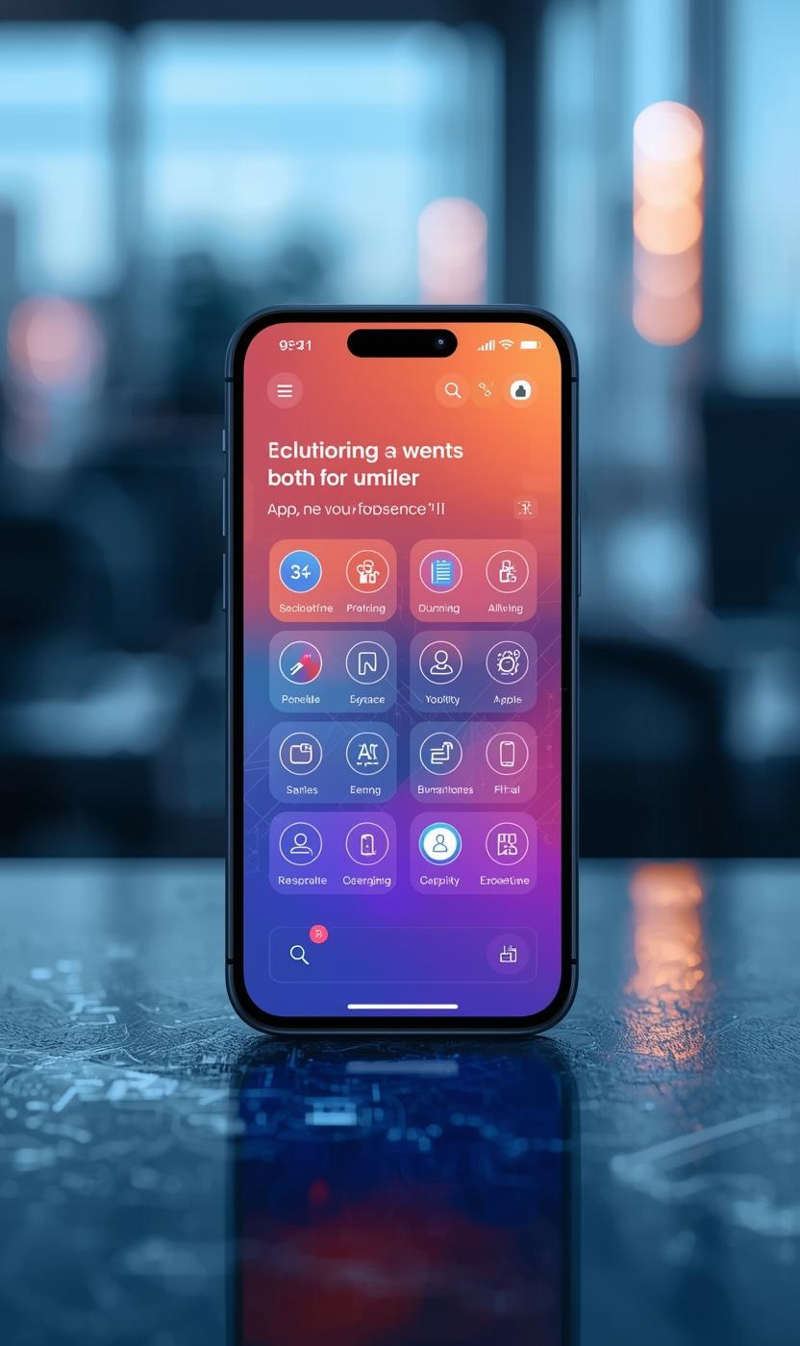
Application of Skills in Real-World Projects
MASTERY AT DEKUT
At the DeKUT Startup Center, I honed my skills through collaborative projects, particularly the Skill Match AI initiative focused on backend architecture.

Slide 8

The Code of My Fathers
WHERE TRADITION MEETS TECHNOLOGY
Irua represents the transformative pain and identity that shapes our understanding of technology and cultural heritage in a rapidly changing world.
RURACIO
Ruracio symbolizes structured commitment and trust, merging traditional values with modern practices to foster growth and harmony in our communities.

Slide 9
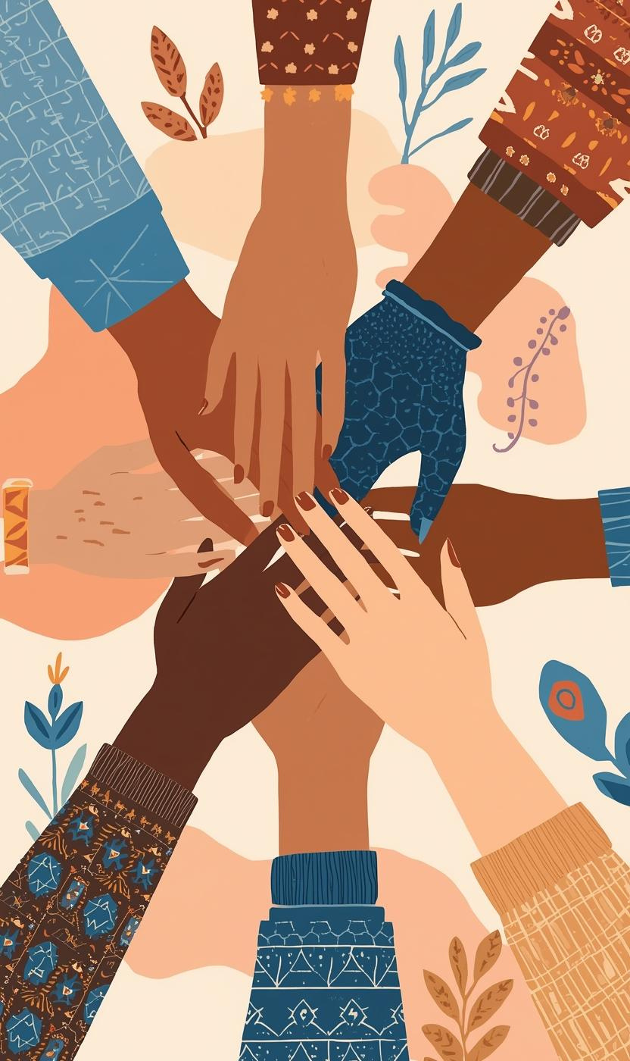
The Women Who Shaped My Journey
MENTORSHIP AND STRENGTH
My journey is deeply influenced by strong women who taught me resilience and collaboration, shaping my path toward success in technology.

Slide 10
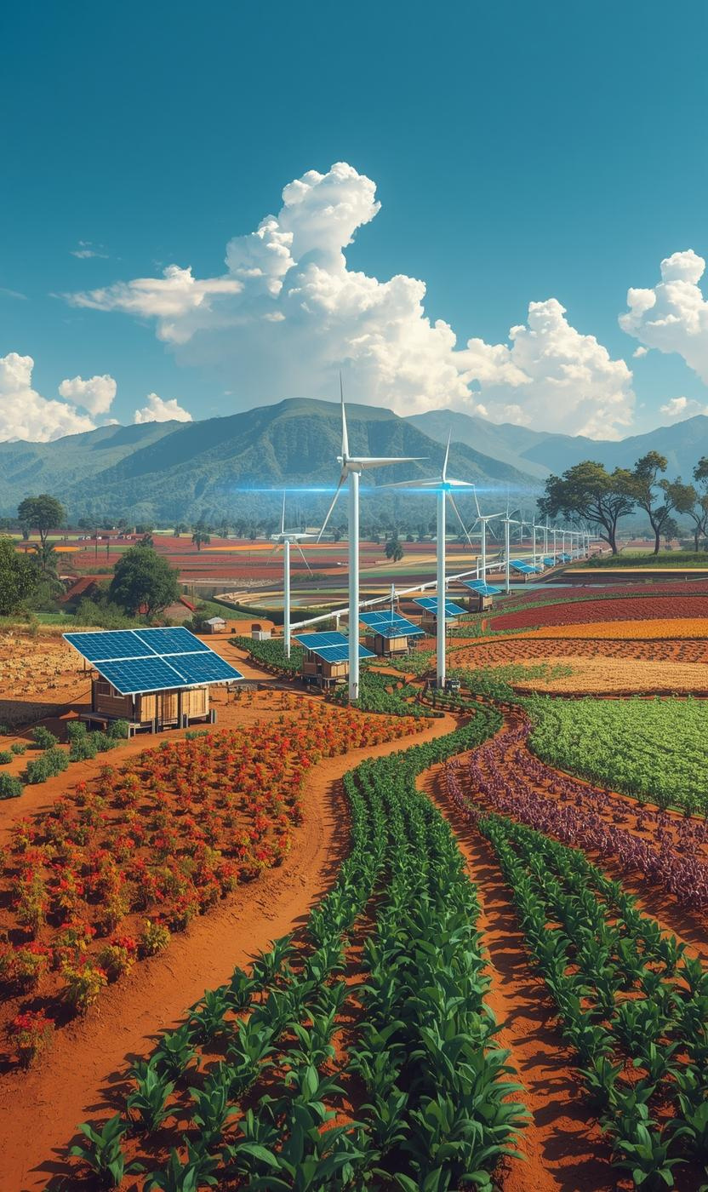
Building a Sustainable Future Through Technology
BRIDGING RURAL AND URBAN
Our vision focuses on leveraging technology to empower rural communities through sustainable agricultural practices and innovative digital solutions.

Slide 11

Technical Skills
NODE.JS
RESTFUL APIS
POSTGRESQL
Node.js is a robust JavaScript runtime that allows for efficient server-side development, enabling real-time web applications and scalability.
RESTful APIs facilitate seamless communication between different software systems, allowing for efficient data exchange and integration across platforms.
PostgreSQL is a powerful open-source relational database management system, known for its reliability, performance, and support for advanced data types and queries.

Slide 12
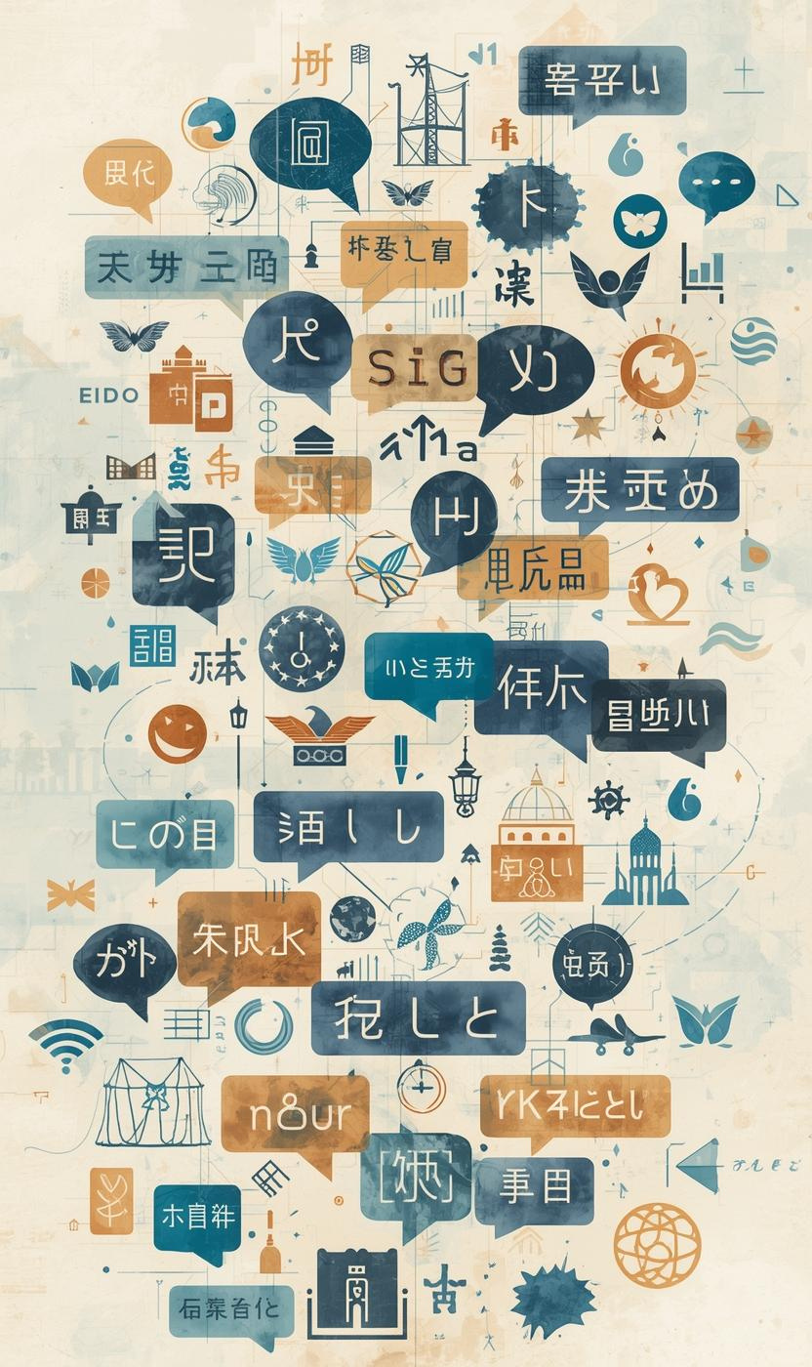
Bridging Cultures Through Language and Communication
MULTILINGUAL CONNECTIONS
Language shapes our identity, fostering connections across cultures and enhancing understanding in technology and community development initiatives.

Slide 13
Acknowledgements and Gratitude
FAMILY SUPPORT
My family's unwavering support has been a vital foundation, nurturing my dreams and instilling resilience, no matter the circumstances.
COUSIN EVA
Cousin Eva's prophetic guidance inspired my journey into technology, pushing me to pursue my passion and embrace my potential.

Slide 14


Thank You for Your Attention

